Slide 1

Visual Analytics
NBA Players Performance 24/25 Interactive Visual Analysis
by Carmella Sta Ana Pana
Sapienza University of Rome
1794019
pana.1794019@studenti.uniroma1.it

Slide 2
Table of contents
8
1
Introduction
Line Chart
2
9
Data and Analytics
Views coordination
3
10
System Design
Insights
4
11
Related works
Players List
5
Radar Chart
6
Scatterplot
7
Parallel Coordinates

Slide 3

Introduction
NBA: premier professional basketball league in the world
Importance of analytics for player evaluation, strategic decisions and player development
Project Purpose: provide a user-friendly interface for analyzing and visualizing NBA players performance data in the 2024-25 Regular Season
Potential users: helpful and intuitive tool for NBA enthusiasts, coaches, team managers, sports analysts etc.

Slide 4
Data and Analytics
INTERESTS
Dataset of NBA players traditional statistics for the ongoing Regular Season 2024-25
512 players
Various metrics between general information and performance
Some additional data containing player’s information and individual stats
Preprocessing: joining by column and converting some values
Analytics with Python Flask backend computation: - Normalization - Efficiency value calculation - Clustering with K-means algorithm - PCA computation - PIE growth trend
PAIN POINTS
PREFERENCES

Slide 5
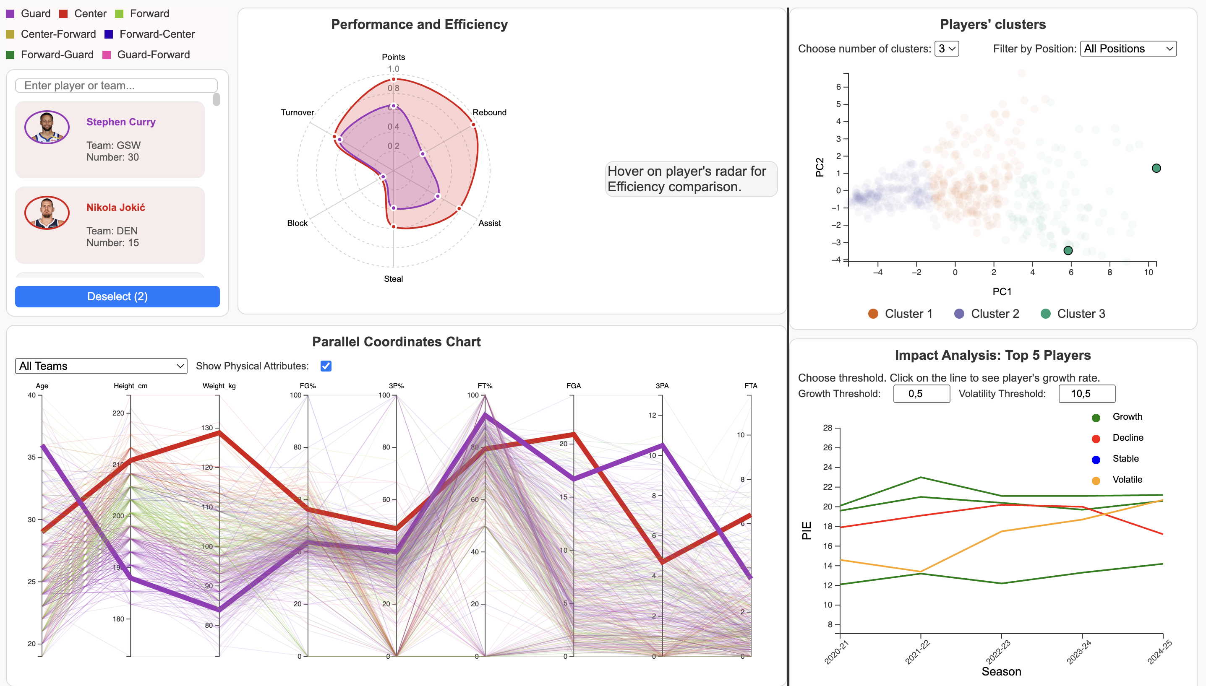
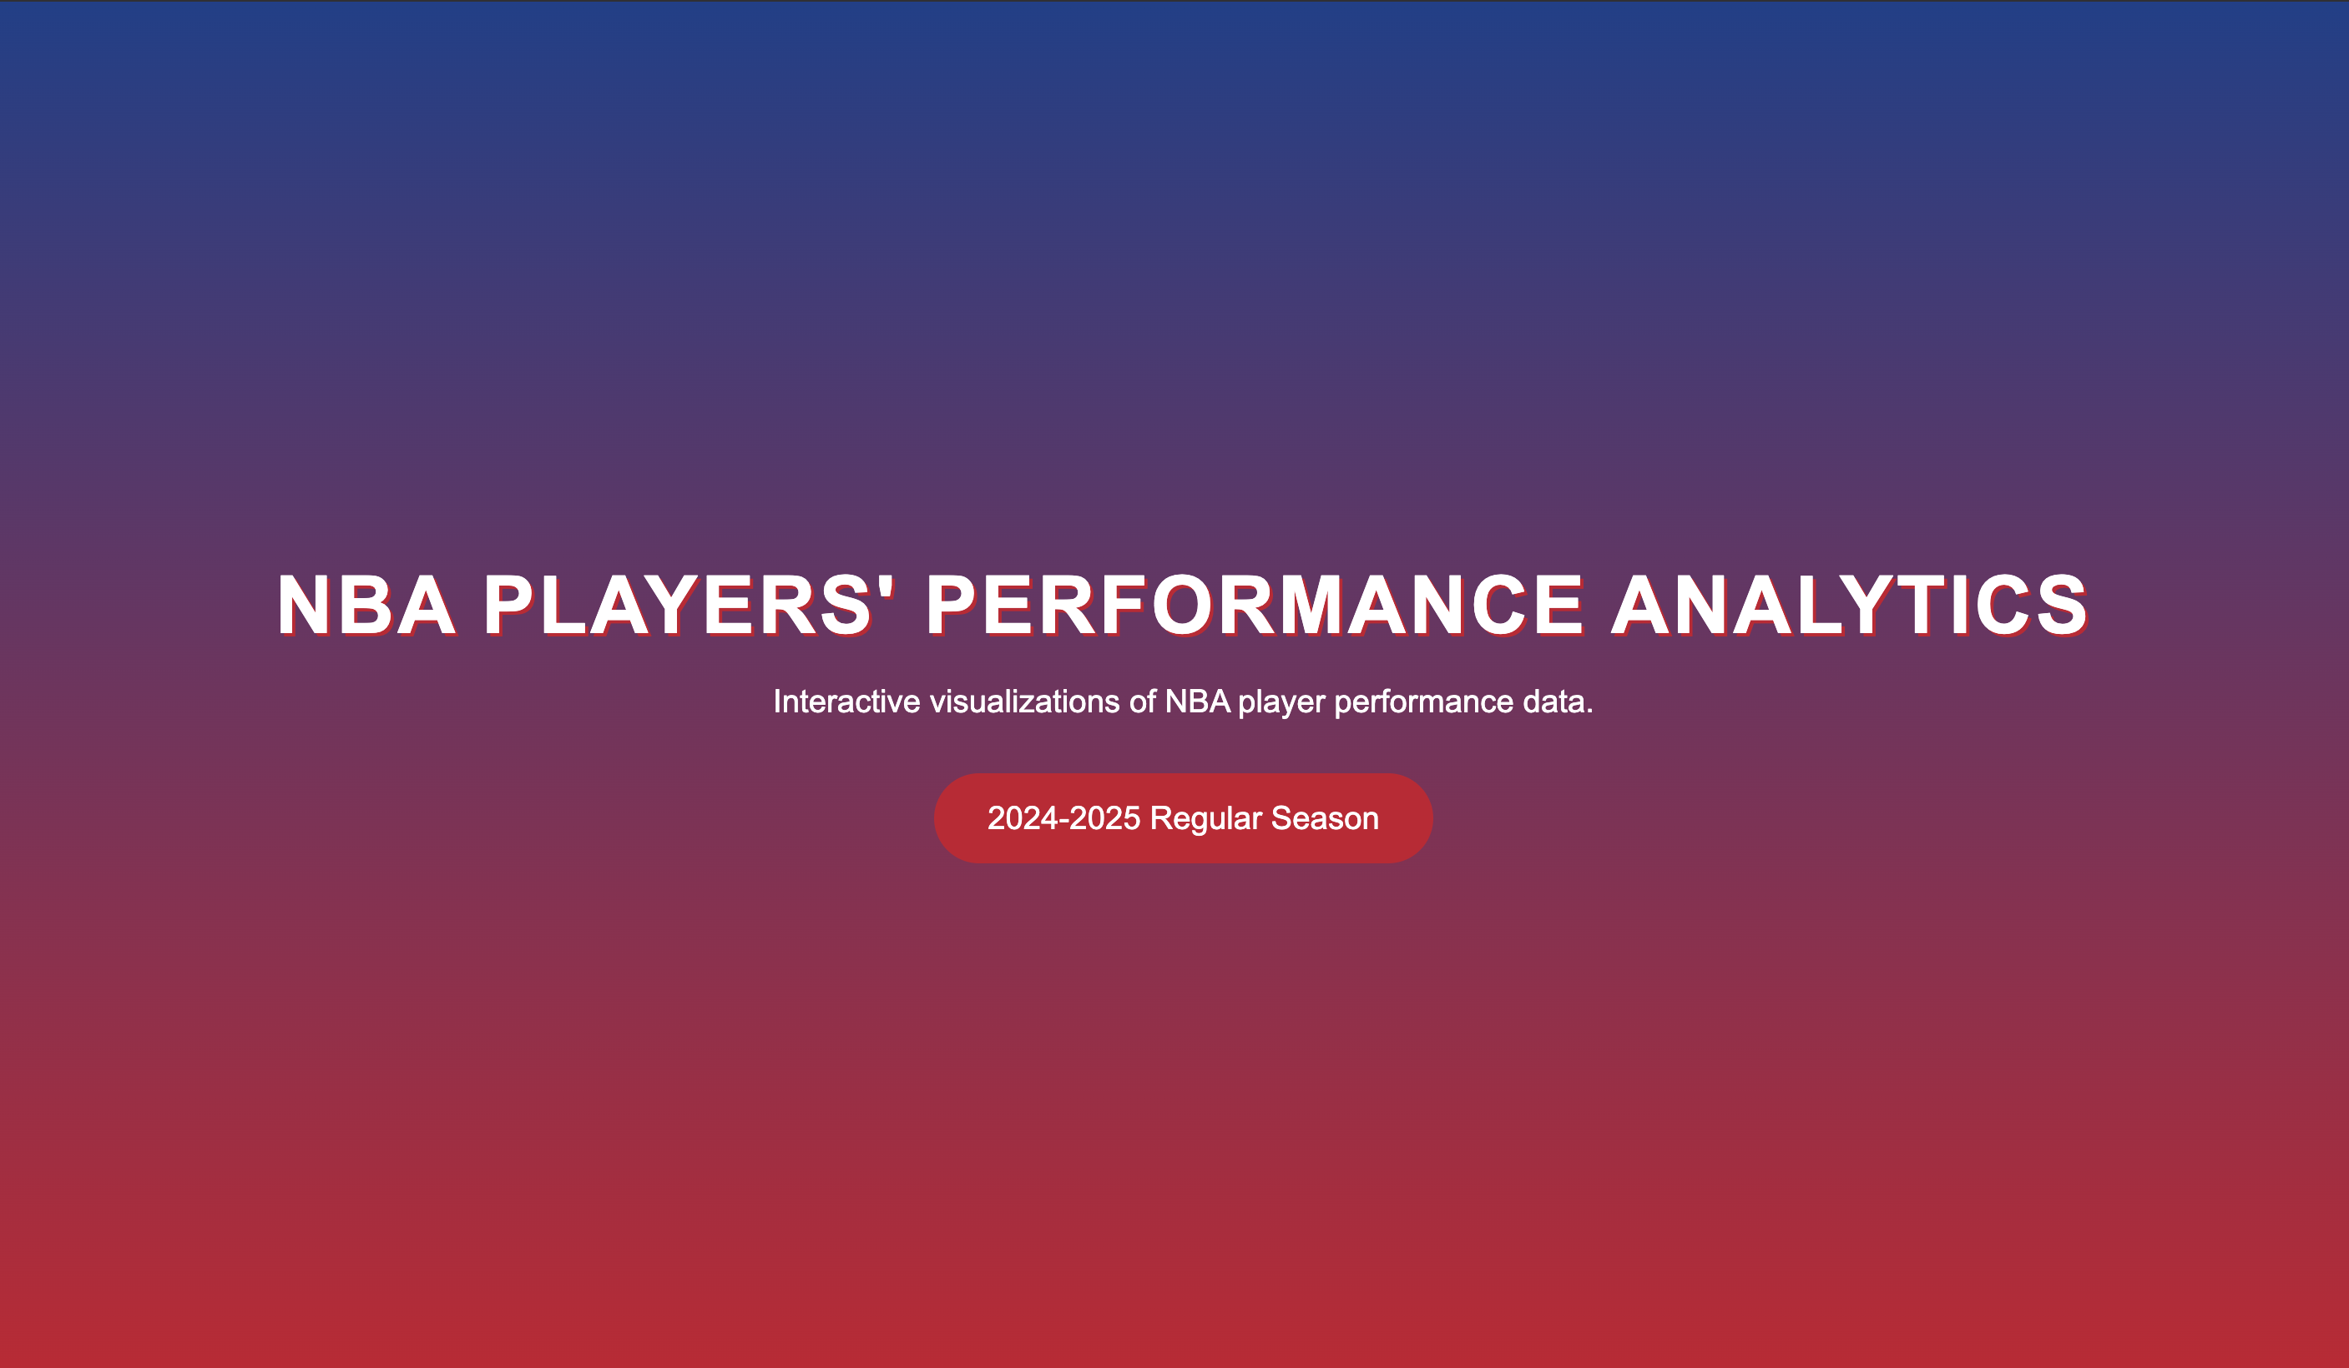
System design
INTERESTS
Welcome page and dashboard
PAIN POINTS
PREFERENCES

Slide 6
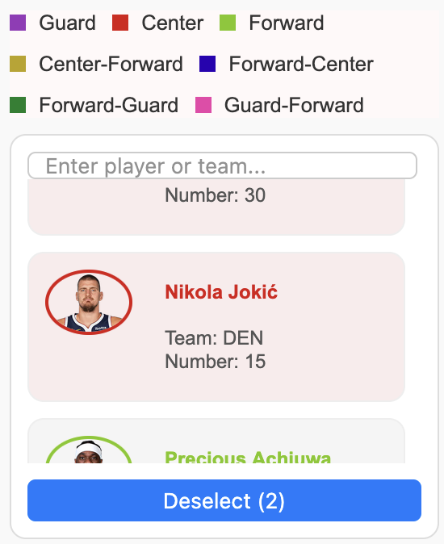
Players List
Scrollable content with list of 24/25 NBA players
List for over 500 players
Each entry contains general information such as full name, team, number and a photo
Color-coding based on positions
Main purpose is to facilitate search and selection of players

Slide 7
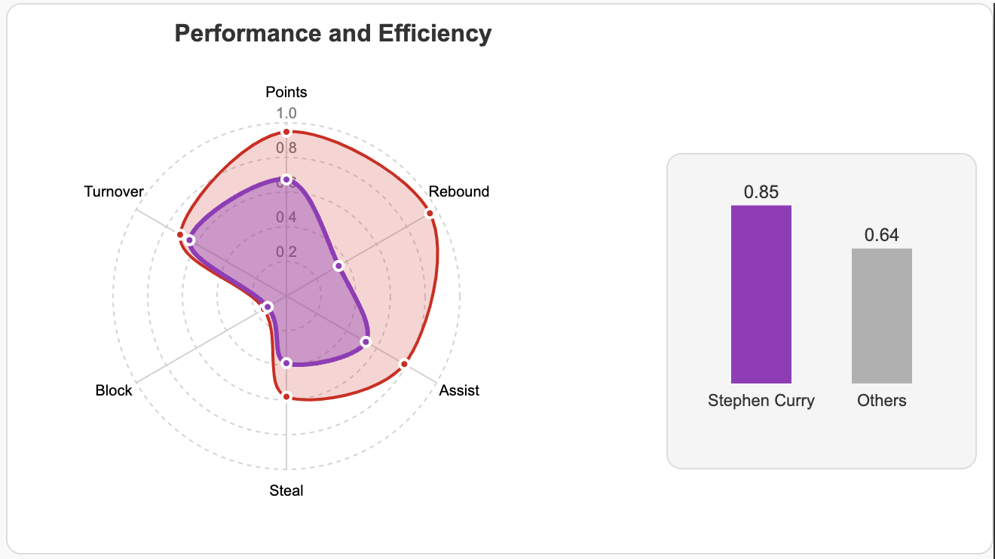
Radar Chart
Individual profiles and efficiency bar chart:
General performance metrics: Points, Rebounds, Turnovers, Assists, Blocks, Steals
Color-coding by position
Coordinated with players list and scatterplot
Efficiency bar gram
Why: useful to focus on individual performance profile; visualize player’s level with respect to others

Slide 8
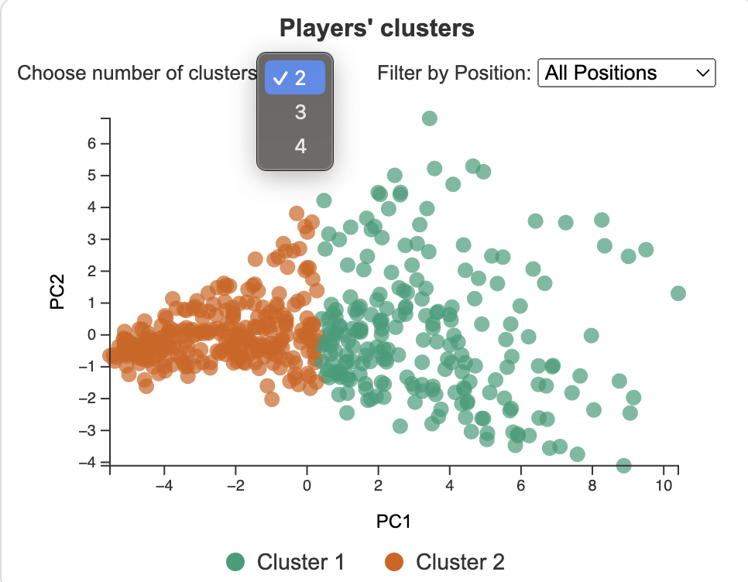
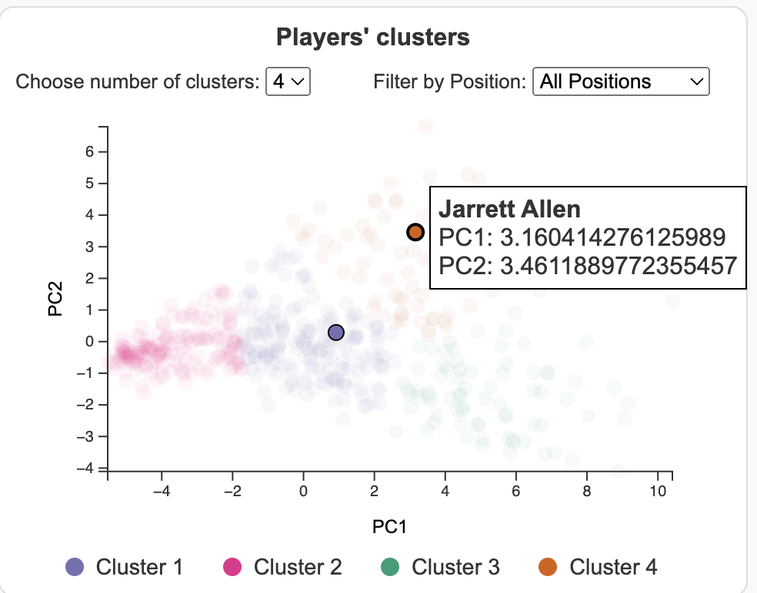
Scatterplot
Clustering of players on overall metrics
Principal Component Analysis: 2 components
Clustering: k-means algorithm
Coordinated with players list
Colors for clusters using d3.scaleOrdinal() with legend
Use: divide the players into clusters, visualize their similarities, find eventual outliers

Slide 9
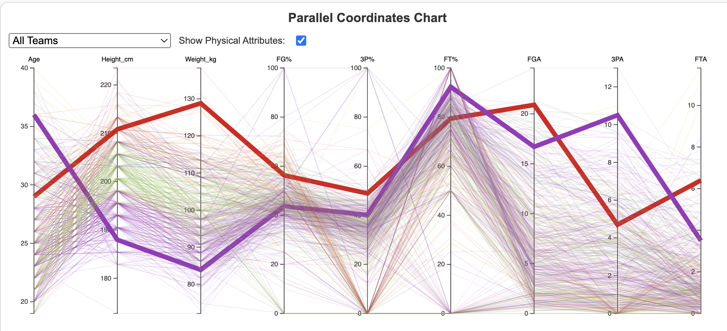
Parallel Coordinates
Players’ physical and shooting attributes
Age, Height and Weight for physical features
Free-throws, 3-Points and Field Goals for shooting features
Color-coded by position
Coordinated with players list and scatterplot
Highlight selected players, filter by teams
Tool for comparing different attributes simultaneously and seeing eventual correlation

Slide 10
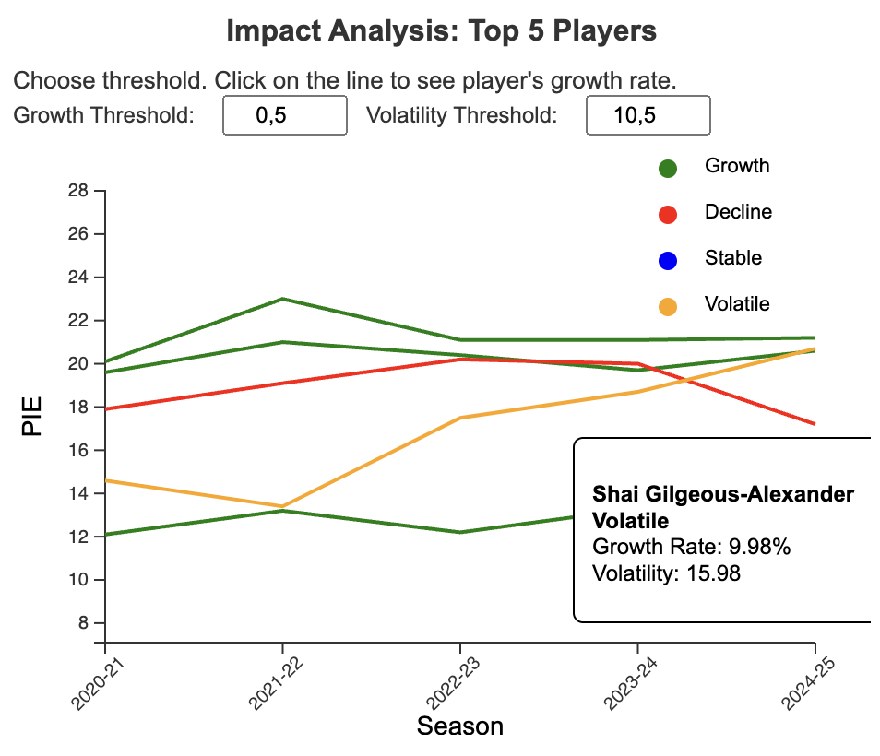
Line Chart
Impact progress of the top 5 Players of this season
Displays PIE (Player Impact Estimate) values of the top 5 players in the past seasons
Color coded based on growth trend
Focus on a small set of players and analyze their performance year-by-year

Slide 11
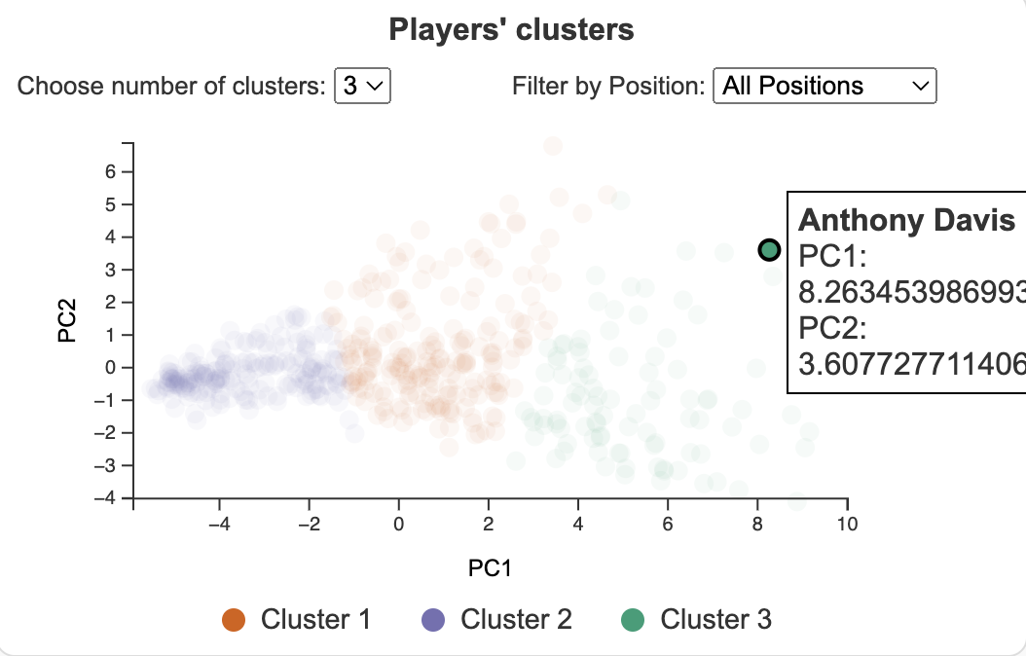
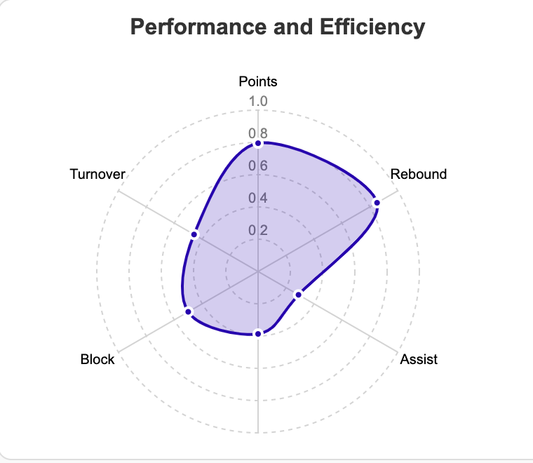
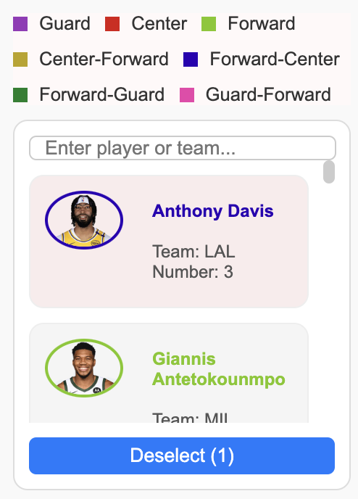
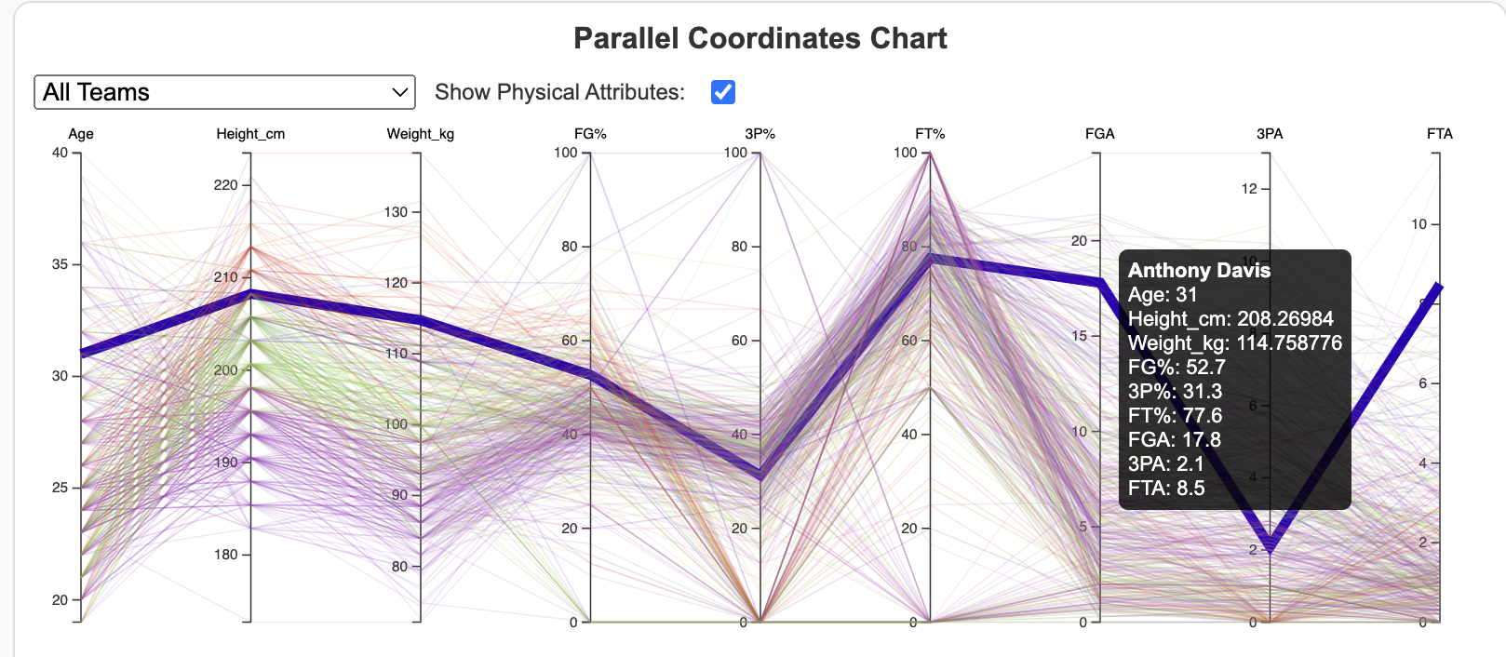
Views coordination
Player selection

Slide 12
Insights
Simplified analysis of NBA players: intuitive tools for fans and analysts to explore player performance
Performance evaluation: - coach can identify ones’ strengths and weaknesses (radar chart) - assessment of players for decision-making on trades or contracts by team managers (efficiency bar)
Discover similarities and unique or excellent athletes (scatterplot)
Shooting skills, also in relation to physical characteristics (parallel coordinates)
Study consistency (line chart)

Slide 13
Related Works
Research example: - “Exploring Game Performance in the National Basketball Association” - “Visual Analaysis of NBA Player Data”
Interactive systems:
“ViziBall”
“NBAVis”
Similar objectives and techniques, different data and approaches

Slide 14
Thank you!

